Slide 1
housekeeping
when coursework splits, if m385 answers m685 questions, thats always extra credit.
quiz 01: q1 (𝔽) all 10 pts ⇒ extra credit; q2 normal; q3 free pts bc my typo; earned pts ⇒ extra credit; qs1,2,3 + q4 = 10 pts earned + 25 pts extra credit; and q5 is its own extra credit.
dept lectures: if you attend math colloquium and engage the speaker, ive marked you down. if you attended and stayed shy or instead watched zoom, submit on your own with text commentary like for stat seminar lecture. if a recording exists, you have until friday may 10 noon to submit; else two weeks.

Slide 2
nmi
2024 spring : lecture 02 : revisit rounding error wrt stability

Slide 3
theorem 01 wrt bound, aggregate error
suppose i = 1,...,n and 0 < δ_{i} ≤ μ_{M} and e_{i} ∈ {-1,+1}. additionally suppose nμ_{M} < 1. then
∏^{n}(1 + δ_{i})^{e_i} = 1 + Θ_{n},
where |Θ_{n}| ≤ Ɣ_{n} ≔ nμ_{M} / (1 - nμ_{M}). ie, Θ_{n} aggregates error and Ɣ_{n} is its bound.
note: μ_{M} is rounding error. in FPS, μ_{M} = ½ ε_{M}, machine error.
proof-lite. (its just a sketch.)
∏^{n}(1 + δ_{i})^{e_i} ≤ ∏^{n}(1 + δ_{i}) ≤ ∏^{n}(1 + nμ_{M}) = (1 + nμ_{M})^{n}.
then by binomial theorem ⇒
(1 + nμ_{M})^{n} ≤ nμ_{M} / (1 - nμ_{M}).
more intensely:
Formal Proofs of Rounding Error Bounds

Slide 4
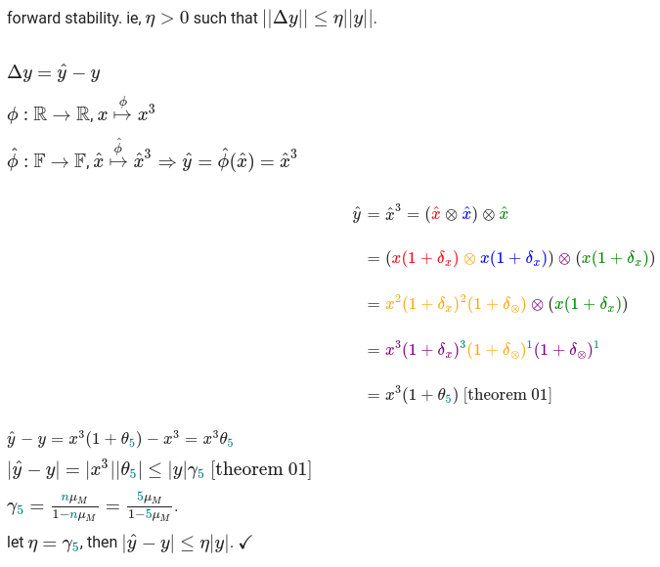
eg 01
forward stability

Slide 5
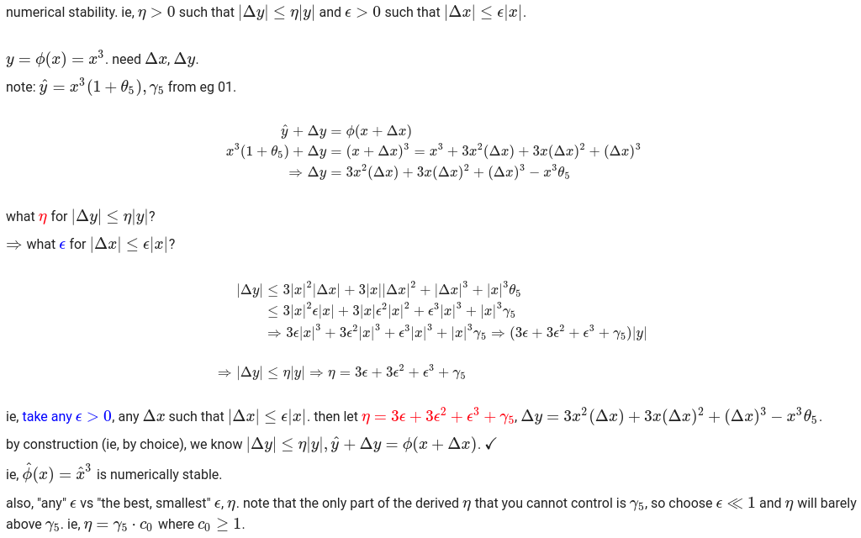
eg 02 numerical stability

Slide 6
nmi
2024 spring : lecture 03 : bisection, fixed-point iteration

Slide 7
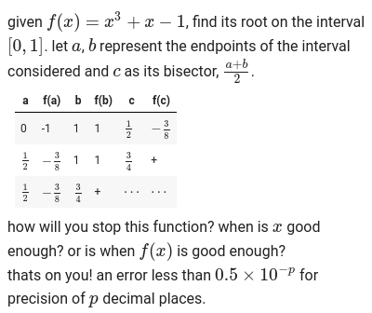
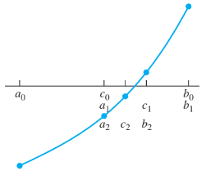
root finding, bisection

Slide 8
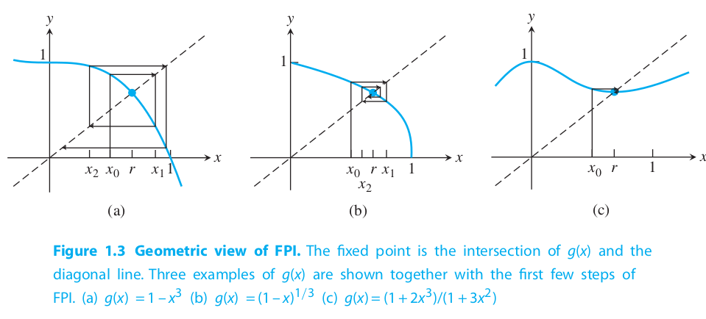
root finding, fixed-point iteration, usw
x_{n+1} = f(x_{n}) with n=0,1,2,...
⇒ x₀, x₁, x₂, … = x₀, f(x₀), f(f(x₀)), …
⇒ f(x_{fix}) = x_{fix}.
eg, rearrange the previous f(x) = x³ + x - 1
⇒ x = 1 - x3 = g(x)
⇒ x₁ = g(x₀), x₂ = g(x₁), x₃ = g(x₂), …
image right shows cobweb pattern of convergence.
and heres another fpi, newton-raphson.
x_{n+1} = x_{n} - f(x_{n})/f'(x_{n}) = g(x_{n}).

Slide 9
fpi, extended
for the first part of this revisitation, lets re-rig that failed example.
start by considering that f(x) = x³ + x -1 has three roots. (thats three roots - not necessarily three distinct roots.) so
f(x) = 0 ⇒ x = 1 - x³ = g(x) ⇒ x_{n+1} = 1 - x_{n}³.
thats the one that barfs, so lets look at what happens when x³ is on the left side of that equation - in colab… refer to blackboard for python notebook, demo_02_rootfinding.
what makes those last two methods increasingly better? #2 addresses that there are three roots and #3 reduces the order of g(x).

Slide 10
next time
newtons method
secant method

Slide 11
homework 02
(30 pts) code to solve root of function, f(x) = x³ + x - 1 over range x ϵ[0,1] using methods: (a) bisection, (b) newton-raphson, (c) secant. stop condition is |Δx| < 0.0001.
(5 pts) explain the difference between newton-raphson and secant root-finding methods.
(15 pts, m685 only) extend lecture example: a) calculate accuracy for f₂(a,b) = a² + 2ab + b²; b) compare with f₁(a,b) = (a + b)²; c) discuss expectations if exponent 2 replaced with increasing n.
due tuesday, february 13, noon
submit via blackboard

Slide 12

please
go away now
stay away these days, too.
2/12 monday holiday
2/19 monday holiday
4/22-4/30 spring break
and do attend bonus thursday
2/22 on monday schedule
i guess

